Slide 1






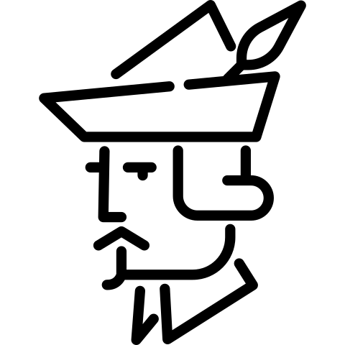

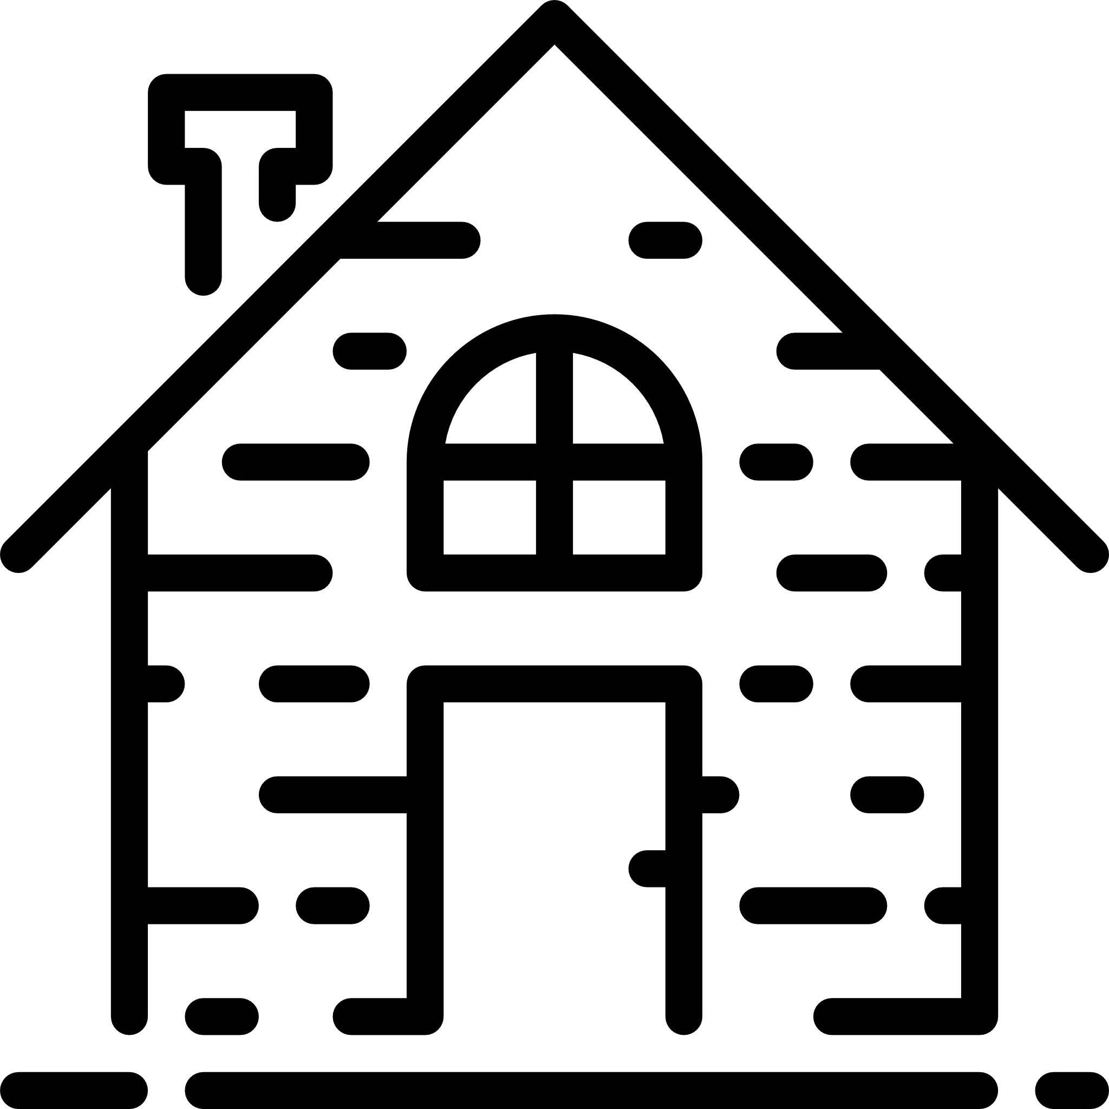
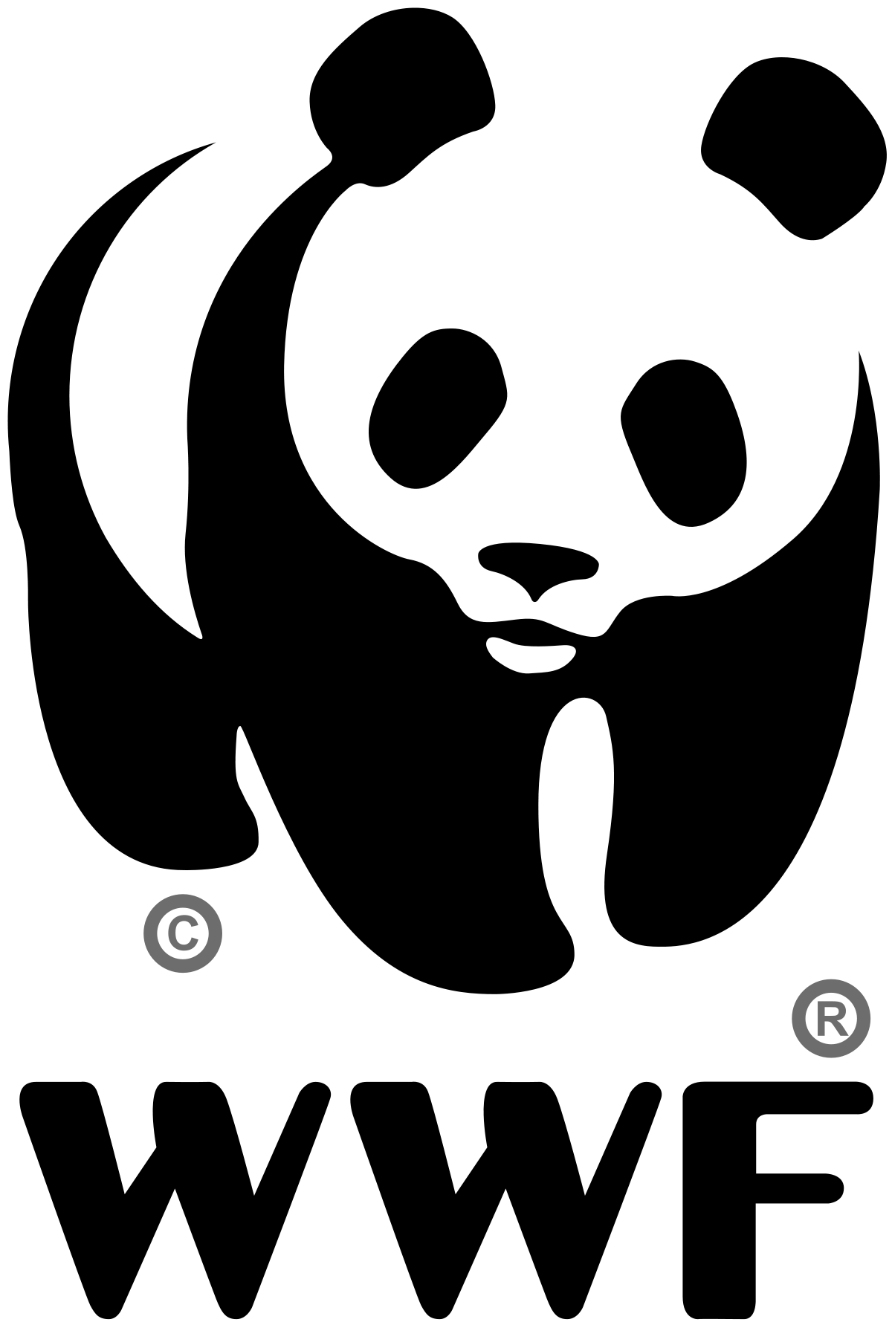


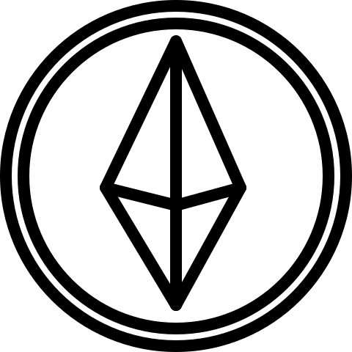

.bioson
CryptoRanger
Performs actions
provides proof
provides
proof
Environment
Data Hunter
Smart Contract (voting)
Community
measure
Institution
oracle
proof
Smart Contract (actions)
sensor proof
IoT network
Smart Contract (collectibles)
recieves data
Donors
Smart Contract (compensation)

Slide 2
.bioson
CryptoRanger
Performs actions
votes on community projects
triggers
provides
proof
Environment
Data Hunter
Smart Contract (voting)
Community
provides proof
defines community projects
defines environmental goals
measure
oracle
proof
Institution
sensor proof
Smart Contract (actions)
IoT network
recieves data
donates ether
Donors
Smart Contract (compensation)
triggers
receives collectibles
Smart Contract (collectibles)

Slide 3
.bioson
CryptoRanger
IoT network
Smart Contract (actions)
Institution
Performs actions
votes on community projects
provides
proof
Environment
Data Hunter
Smart Contract (voting)
provides proof
measure
Community
Smart Contract (compensation)
Donors
sensor proof
donates ether
recieves data
defines community projects
defines environmental goals
oracle
proof
receives collectibles
triggers
Smart Contract (collectibles)
triggers

Slide 4
.bioson
CryptoRanger
Environment
Data Hunter
Smart Contract (voting)
IoT network
Smart Contract (collectibles)
Smart Contract (actions)
Institution
Donors
Community
donates ether
recieves data
Smart Contract (compensation)
sensor proof
defines community projects
measure
defines environmental goals
oracle
proof
triggers
receives collectibles
triggers

Slide 5
.bioson
CryptoRanger
Institution
provides proof
Performs actions
votes on community projects
triggers
provides
proof
Smart Contract (voting)
Community
Environment
Data Hunter
defines community projects
defines environmental goals
measure
oracle
proof
sensor proof
recieves data
IoT network
Smart Contract (actions)
donates ether
Donors
Smart Contract (compensation)
triggers
receives collectibles
Smart Contract (collectibles)

Slide 6
.bioson
CryptoRanger
conducts actions
provides proof
source of proof
defines community projects
Data Hunter
institution proof
WWF
votes on community projects
defines environmental goals
receives voting rights
sensor proof
triggers voting rights
Environment tracking
video (animal tracking)
audio (animal tracking)
dedicated gps (animal tracking)
Satellite (deforestation tracking)
CO2 sensors (environment tracking)
Smart Contract (actions)
Smart Contract (voting)
hunter
compensation
triggers
hunter
compensation
Triggers community
compensation
triggers collectible distribution
community
compensation
Community
Smart Contract (collectibles)
Smart Contract (compensation)
receives collectibles
donates
ether
receives
Environment & action data
Action stream
Collectible stream
Community/ voting stream
Compensation/ ether stream
Donors

Slide 7
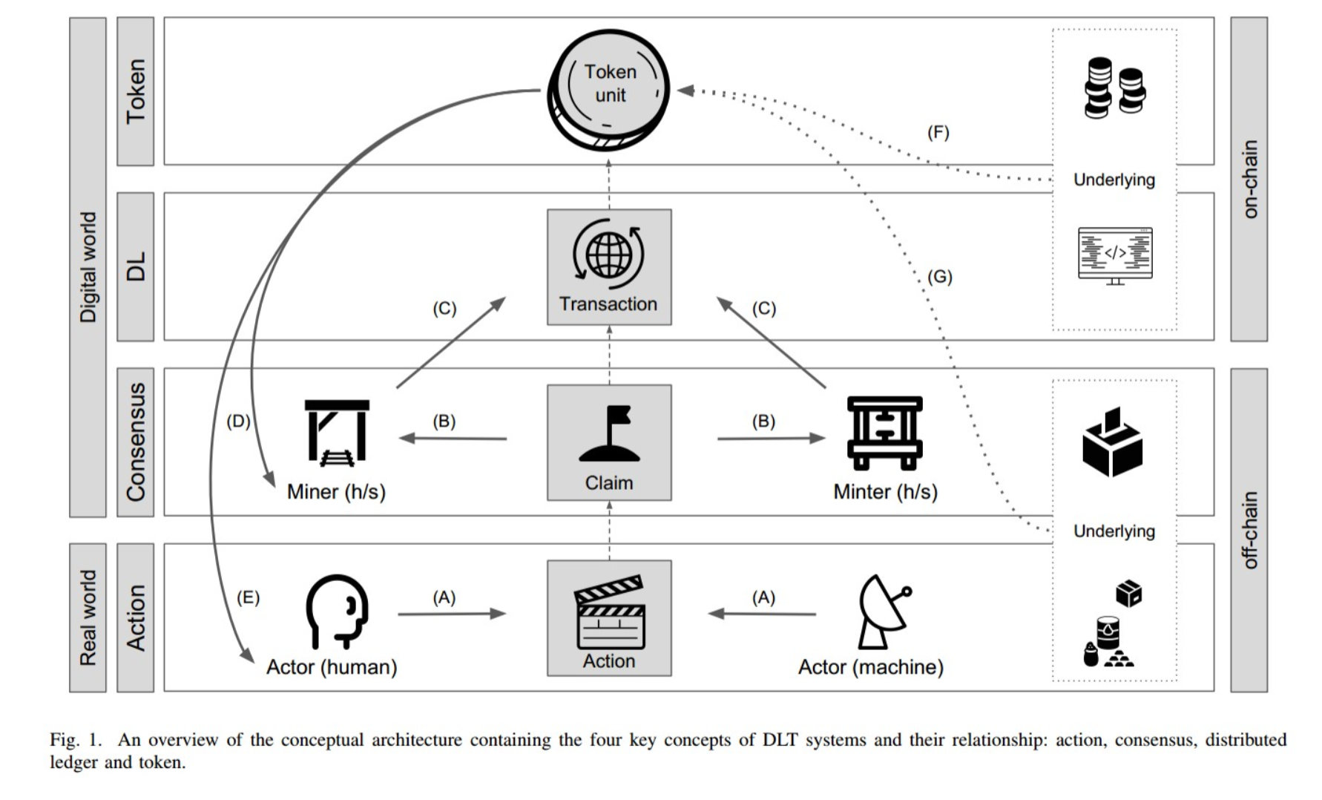
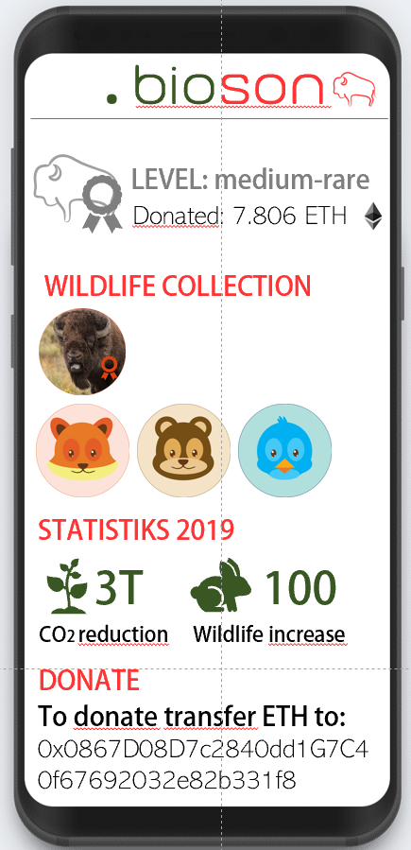
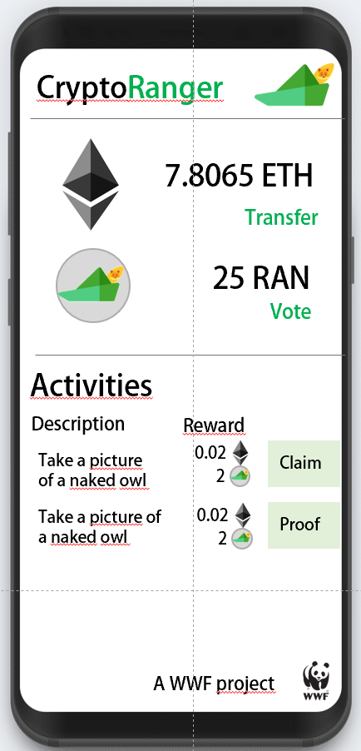
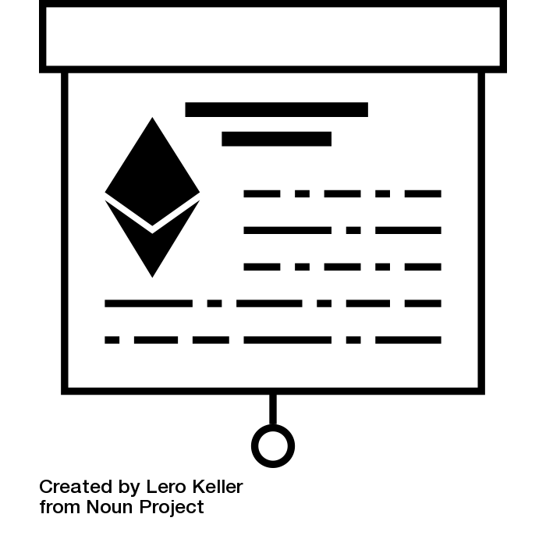
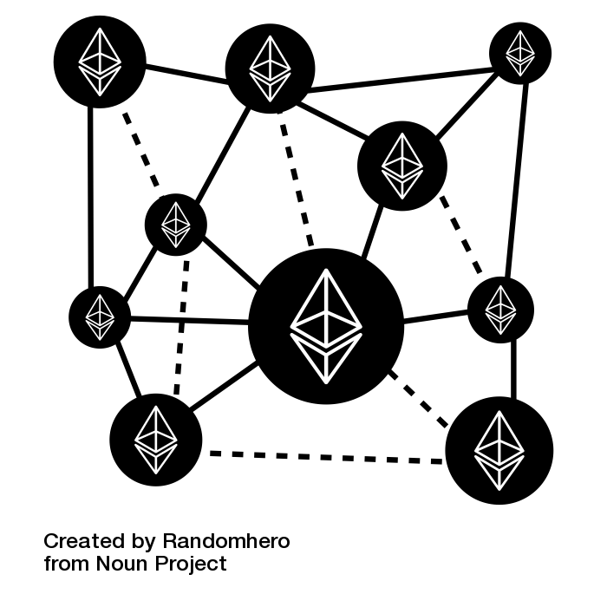

bioson
Webapp
CryptoRanger
Webapp
Sensors
Display sensor data,environmental impact collectible tokens,
Conduct environmental actions, proof actions, receive rewards, vote on projects
Application
Sensor Proof of conducted actions
Ethereum Smart Contracts
Fin4 Token Management
Interaction
Conduct transactions based on pre-defined rules
ERC20 Tokens, ERC721 Tokens, Voting rights
Ethereum Blockchain
BigChain DB
IPFS
Storage
Store transactions
store asset details
& sensor data
store proof data (video, text)

Slide 8
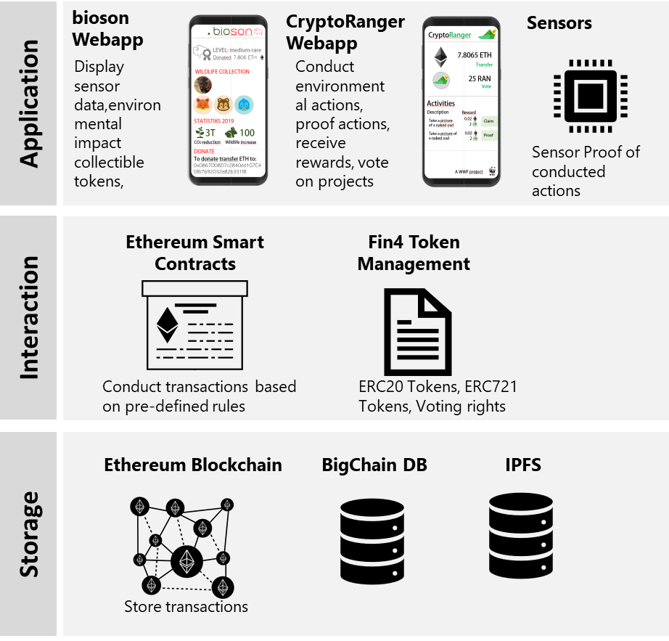

Slide 9

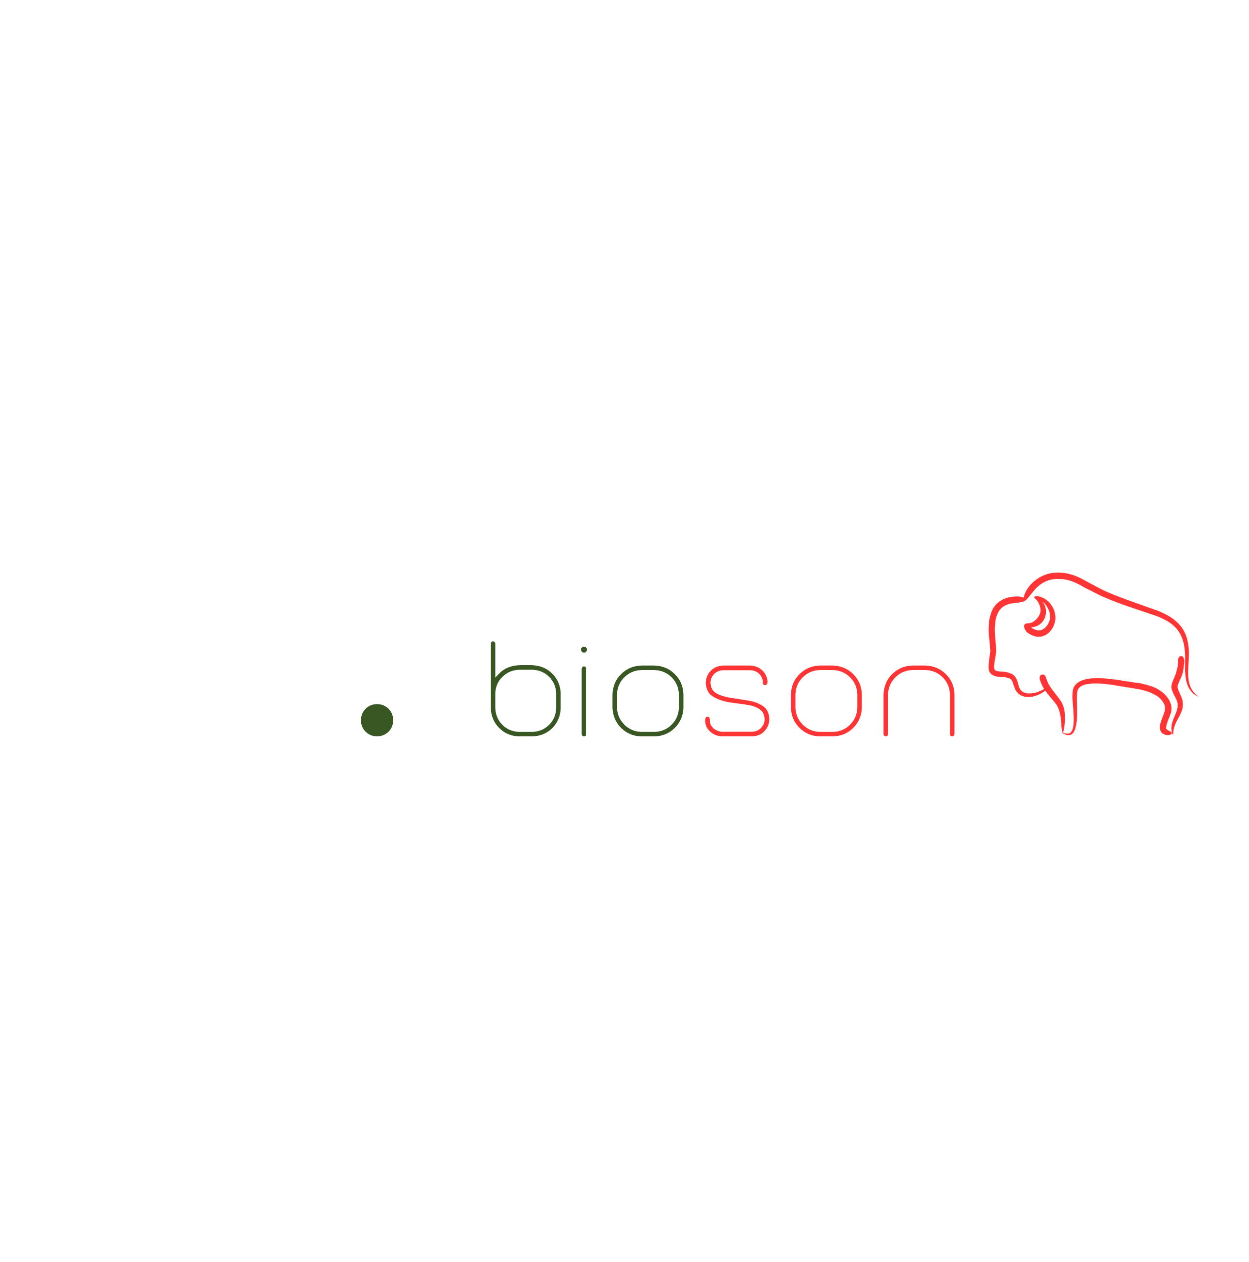
Project Byson
https://github.com/betherworld/byson
The Challenge
How can we use smart contracts to hold the money in escrow that is in the bonus pot and only release it in case the impact goals are met?
How can we use blockchain tokens to incentivize community participation and give them the ability to vote for bonus fund use as described above?
How can blockchain support in controlling that community actions have been conducted as planned? How can we show results of project actions and impact goals?
Tokenization?
Blockchain? Energy efficiency? Really needed?
CryptoRanger
Alessandro
Tarantola
Chaoran
Chen
David
Ittah
Sergiu
Soima
Severin
Kranz

Slide 10
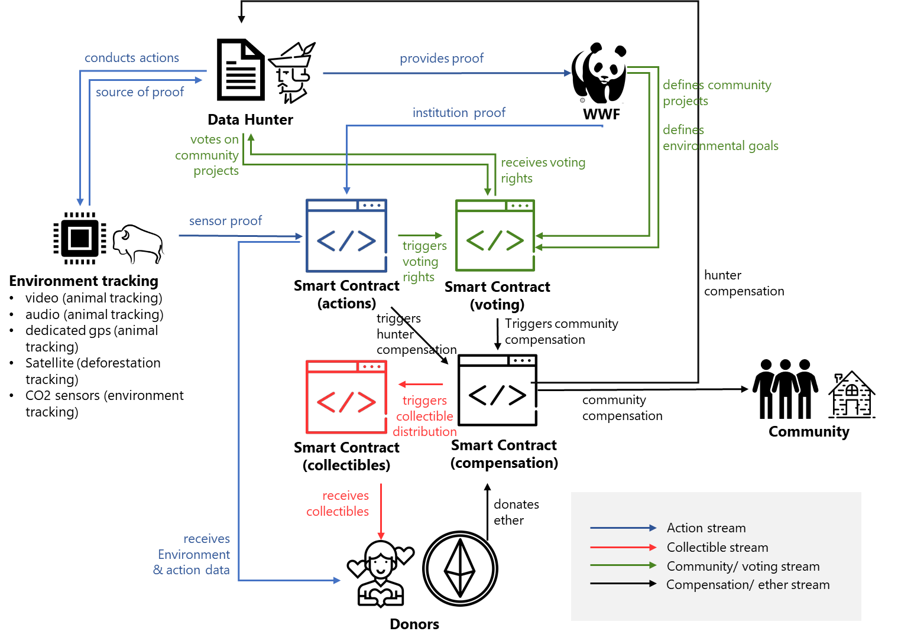
Crypto-Economic Design
System Architecture
The Idea
Doners: donate cryptocurrency specifying the percentage they want to devolve to the community and to the hunters/gatherers directly. Get no fungible tokens in exchange (i.e. cryptobisons). They have access to data (stored in the blockchain) about the present state of certain main goals that have to be achieved

Slide 11
Disruption Potential
For the Environment
For the Community
For the Doners
Doners: donate cryptocurrency specifying the percentage they want to devolve to the community and to the hunters/gatherers directly. Get no fungible tokens in exchange (i.e. cryptobisons). They have access to data (stored in the blockchain) about the present state of certain main goals that have to be achievedDoners: donate cryptocurrency specifying the percentage they want to devolve to the community and to the hunters/gatherers directly. Get no fungible tokens in exchange
Doners: donate cryptocurrency specifying the percentage they want to devolve to the community and to the hunters/gatherers directly. Get no fungible tokens in exchange (i.e. cryptobisons). They have access to data (stored in the blockchain) about the present state of certain main goals that have to be achieved
Doners: donate cryptocurrency specifying the percentage they want to devolve to the community and to the hunters/gatherers directly. Get no fungible tokens in exchange (i.e. cryptobisons). They have access to data (stored in the blockchain) about the present state of certain main goals that have to be achieved
Doners: donate cryptocurrency specifying the percentage they want to devolve to the community and to the hunters/gatherers directly. Get no fungible tokens in exchange (i.e. cryptobisons). They have access to data (stored in the blockchain) about the present state of certain main goals that have to be achieved
Doners: donate cryptocurrency specifying the percentage they want to devolve
to the community and to the hunters/gatherers directly. Get no fungible tokens
Doners: donate cryptocurrency specifying the percentage they want to devolve
to the community and to the hunters/gatherers directly. Get no fungible tokens
Doners: donate cryptocurrency specifying the percentage they want to devolve
to the community and to the hunters/gatherers directly. Get no fungible tokens

Slide 12
Potential negative outcomes
Open questions and ideas
Challenges
General description
Doners: donate cryptocurrency specifying the percentage they want to devolve to the community and to the hunters/gatherers directly. Get no fungible tokens in exchange (i.e. cryptobisons). They have access to data (stored in the blockchain) about the present state of certain main goals that have to be achieved
Doners: donate cryptocurrency specifying the percentage they want to devolve to the community and to the hunters/gatherers directly. Get no fungible tokens in exchange (i.e. cryptobisons). They have access to data (stored in the blockchain) about the present state of certain main goals that have to be achieved
Doners: donate cryptocurrency specifying the percentage they want to devolve
to the community and to the hunters/gatherers directly. Get no fungible tokens
Doners: donate cryptocurrency specifying the percentage they want to devolve
to the community and to the hunters/gatherers directly. Get no fungible tokens

Slide 13
Software Demo
Insert Youtoube Link
Listen to the users of our application and checkout our software demo to get an idea of how our ecosystem might look like.

Slide 14
Byson is a business ecosystem to protect the European nature and wildlife. It consists out of four main parties. The doners donate cryptocurrency to a smart contract y specifying the percentage they want to devolve to the community and to the hunters/gatherers directly. Get no fungible tokens in exchange (i.e. cryptobisons). They have access to data (stored in the blockchain) about the present state of certain main goals that have to be achieved and future projects for the development of the community. Such goals are defined by WWF (e.g increase in number of bisons, large carnivores, bugs, etc.). The proof of a goal being achieved should be automatic and triggered by IoT devices displaced in the area.
2. Community: A considerable amount of funding gets stored in a “community pot”. It is made available once certain Impact Goals have been achieved (proof as before). The hunters/gatherer then vote the project the want to realize with that money, using a Voting Token received for performing proven actions. Projects are chosen by WWF.
3. Hunters/gatherers: perform actions that help implement/maintain IoT structure or actively contribute in preserving the area. For every such actin they receive a money-equivalent cryptocurrency (i.e. ether) as well as a certain amount of voting tokens (VT), to be used as specified before.
4. Nature: IoT sensors to confirm that actions have really been carried out.
5. WWF: take part of the funds to continue doing their everyday tasks. Decide alongside local governance the projects that could be realized with the community pot.

Slide 15






ACTIONS
V
ENVIRONMENT
DATA HUNTER/GATHERER
PROOF (IoT)
METADATA
V
METADATA
RELEASE BONUS FUNDS
COMMUNITY
IMPACT GOALS
CRYPTOBISONS
DONORS

Slide 16
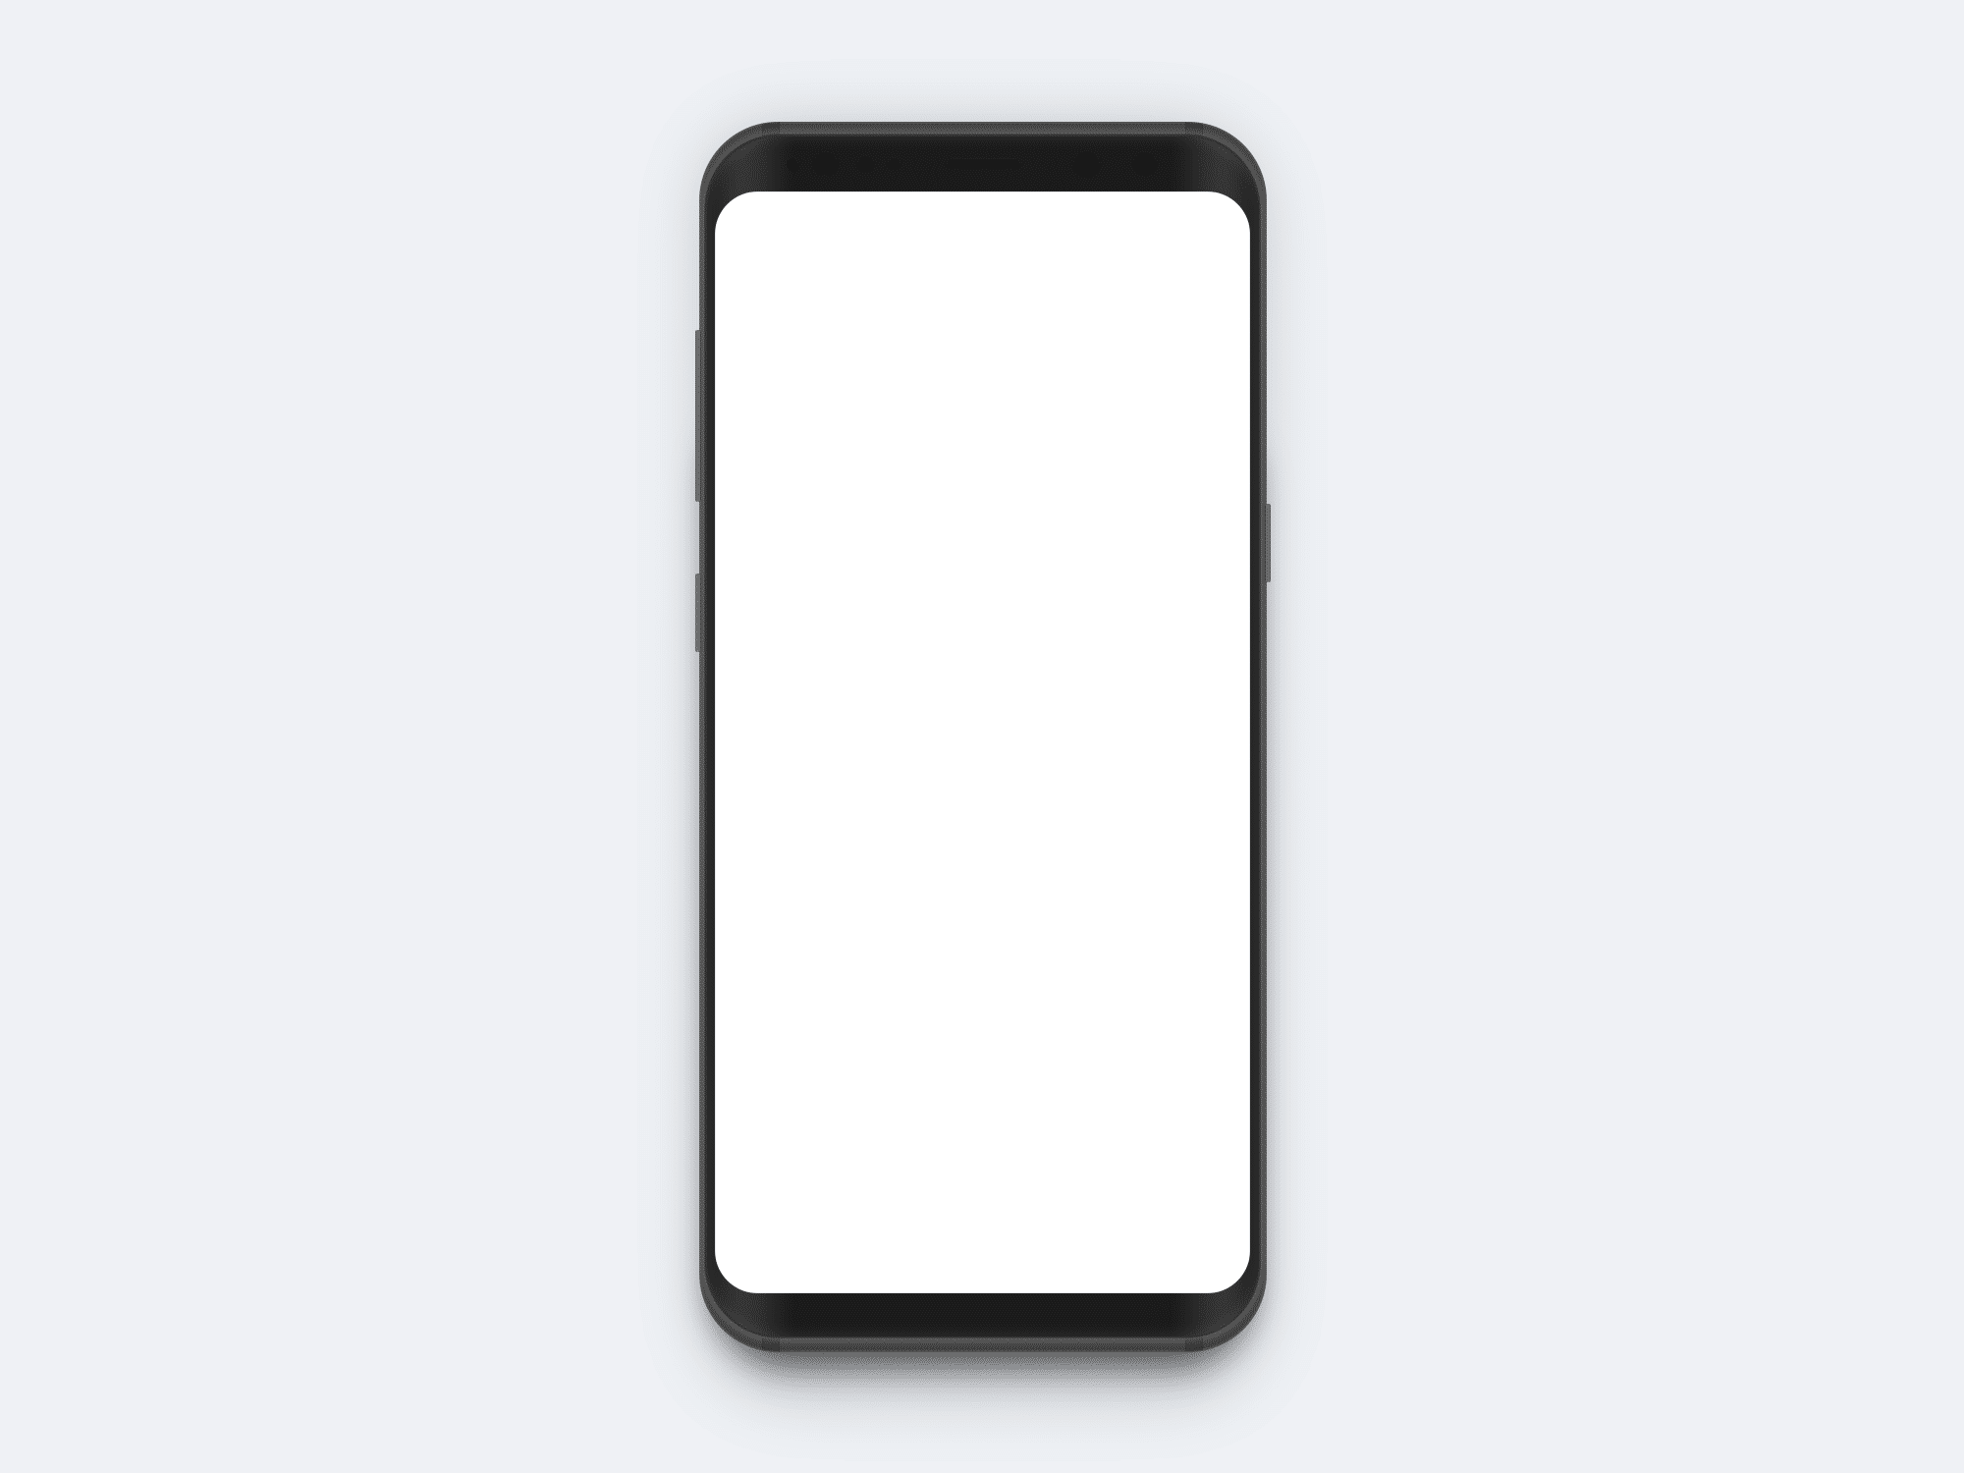
CryptoRanger

Slide 17
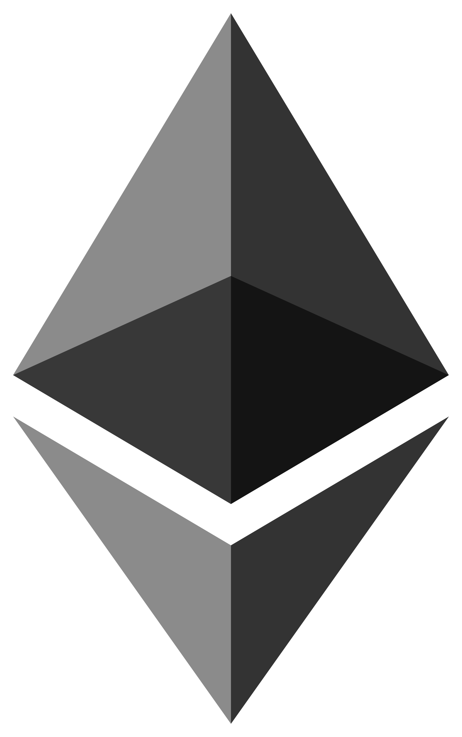
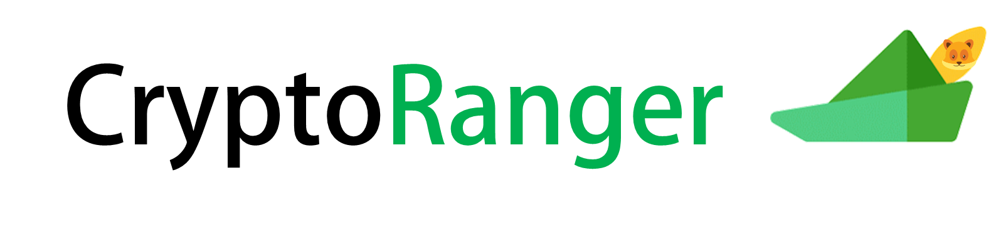
CryptoRanger
CryptoRanger
7.8065 ETH
Transfer
25 RAN
Vote
Activities
Description
Reward
Take a picture of a naked owl
0.02
Claim
2
Take a picture of a naked owl
0.02
Proof
2
A WWF project

Slide 18



ProofActivity
Take a picture of a naked owl
Acceptance Criteria
- Take a picture of an owl within the App
Proof
Type in your comment...
A WWF project

Slide 19

CommunityVote
Vote for your favourite Community Project!
Your Balance:
25 RAN
Present Projects
Project
Vote
Building a Disco
15
New Well in Siebenbürgen
10
Rennovate Hospital in Brasov
0
Vote
If the impact goals are met, the project with the most votes gets funded.
A WWF project

Slide 20

ImpactGoals
Your community is on the right track!
80%
Next Project to be realized:
- Local Disco
Bisons in defined area:
25/40
Wolfs in defined area:
4/6
Healthiness of forests:
85/100
Disturbances by shephards:
2
Perform further actions to reach the impact goals.
A WWF project

Slide 21
ImpactGoals
Your community is on the right track!
80%
Next Project to be realized:
- Local Disco
Bisons in defined area:
25/40
Wolfs in defined area:
4/6
Healthiness of forests:
85/100
Disturbances by shephards:
2
Perform further actions to reach the impact goals.
A WWF project

Slide 22


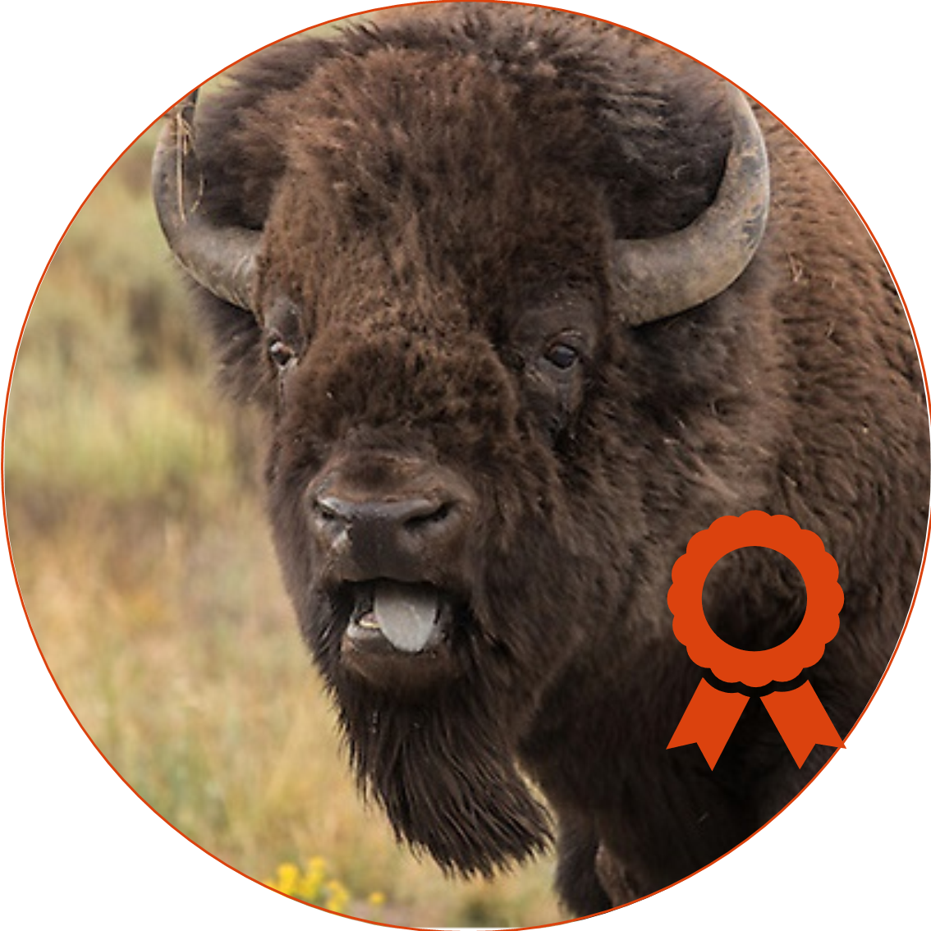
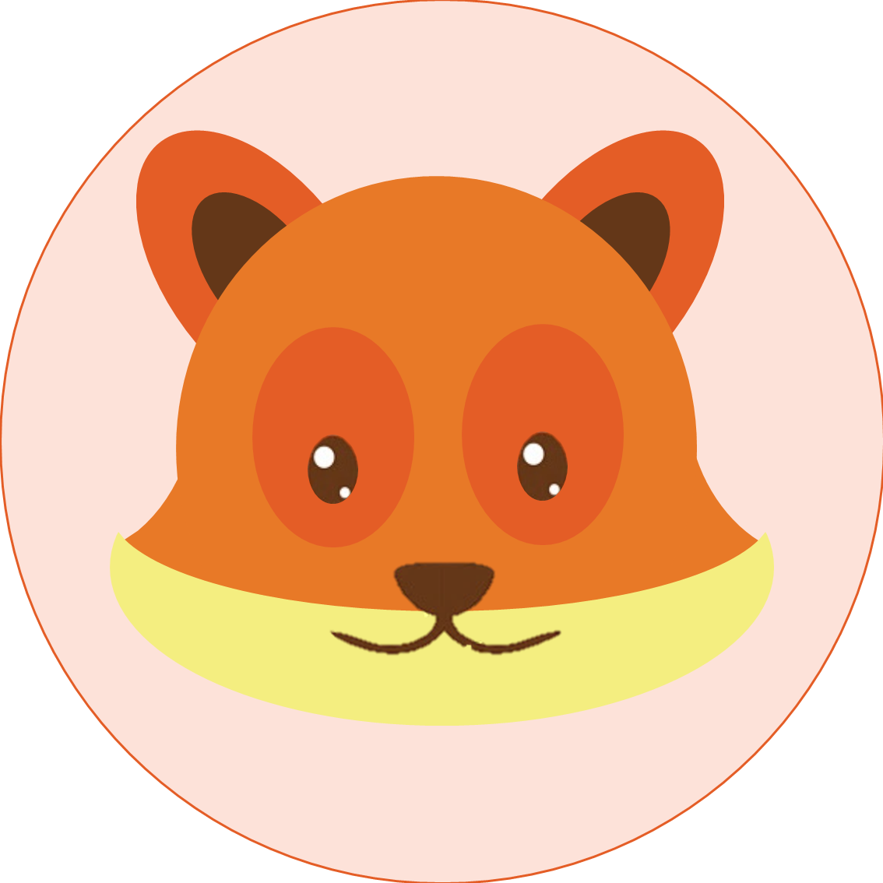




.bioson
LEVEL: medium-rare
Donated: 7.806 ETH
WILDLIFE COLLECTION
STATISTIKS 2019
3T
100
CO2 reduction
Wildlife increase
DONATE
To donate transfer ETH to:
0x0867D08D7c2840dd1G7C40f67692032e82b331f8

Slide 23
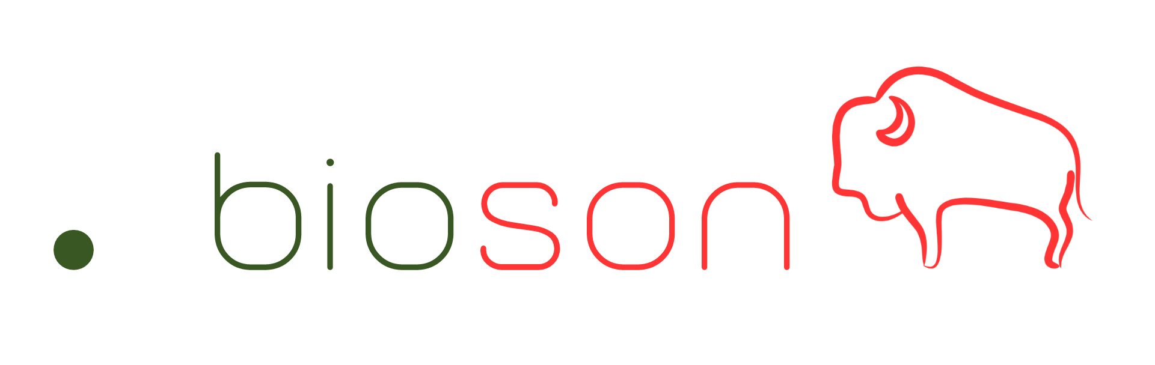
.bioson
LEVEL: medium-rare
Donated: 7.806 ETH
WILDLIFE COLLECTION
STATISTIKS 2019
More...
3T
100
CO2 reduction
Wildlife increase
DONATE
To donate transfer ETH to:
0x0867D08D7c2840dd1G7C40f67692032e82b331f8

Slide 24
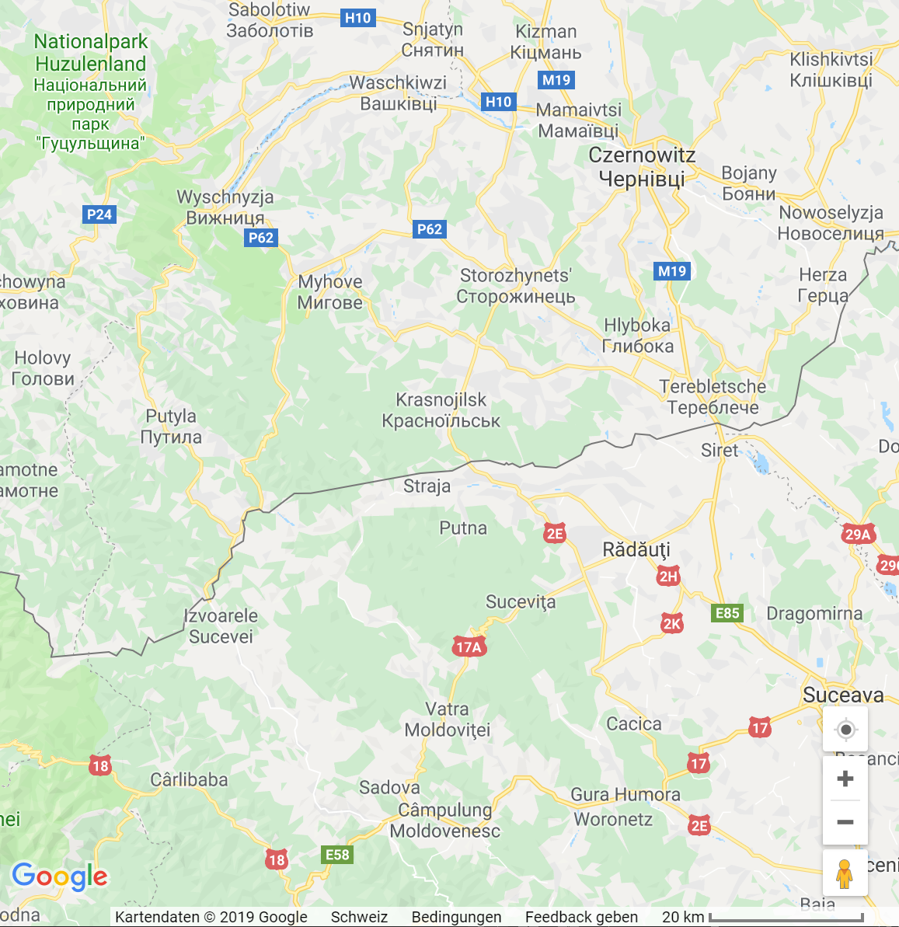

.bioson
MY BIOson
Peter
Name:
7 years
Age:
Area:
Karpaten
Auction
STALK PETER

Slide 25
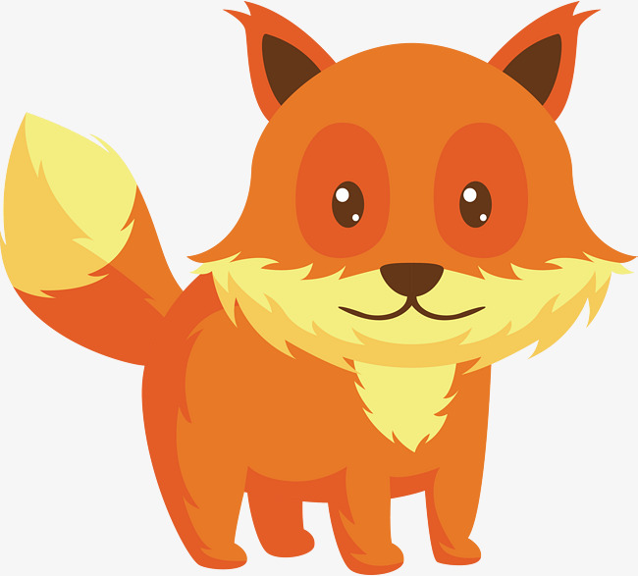
.bioson
FOX TROTT
BIOgraphy
Yarr matey. I’m Fox Trott, and I'm not here to make friends, I'm here to win. Pursuing a career in being a Penguin Charmer has been exhausting, so I'm switching paths to be become a Ventriloquist. You and I go together like peanuts and Big Mac sauce.
Attributes
fur: orange
eyes: dark orange
ears: sharp
Auction

Slide 26
.bioson
ENVIRONMENT
3T
100
CO2 reduction
Wildlife increase
Bisons in defined area:
25/40
Wolfs in defined area:
4/6
Healthiness of forests:
85/100
2
Disturbances by shephards:
COMMUNITY
Progress: 80%
Next Project to be realized:
Local Disco Brasov
Already realized:
Well in Brasov
Rennovate Hospital in Siebenbürgen

Slide 27




.bioson

